Slide 1

Basic Inorganic Chemistry For B.Tech & B.Sc I yr
Organometallic Chemistry
( 4 lectures)
The 18 electron rule, Metal Carbonyls and sandwich compounds, Unique reactions of organometallics and their use in explaining homogeneous catalysis
Prepared by Prof. Anil J. Elias, IIT Delhi

Slide 2
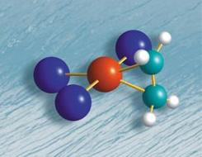
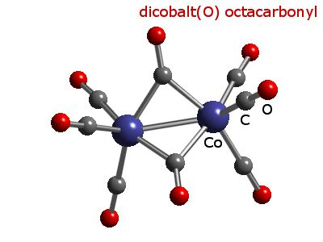
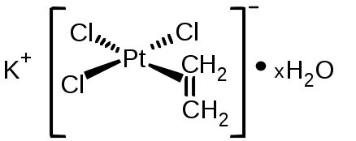
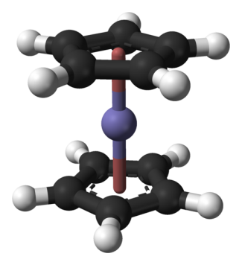
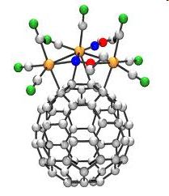
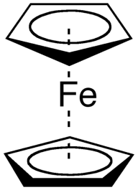
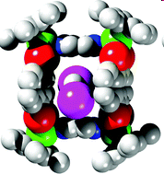
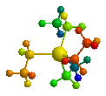
Organometallic Chemistry
An area which bridges organic and inorganic chemistry
A branch of coordination chemistry where the complex has one or more metal-carbon bonds
The metal-ligand interactions are mostly π acid type
M-C bond can be a σ type or π type bond

Slide 3
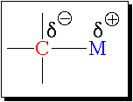
What all compounds are considered as organometallic?
C always more electronegative compared to M
The leading journals of the field define an "organometallic" compound as one in which there is a bonding interaction (ionic or covalent, localized or delocalized) between one or more carbon atoms of an organic group or molecule and a main group, transition, lanthanide, or actinide metal atom (or atoms).
Following longstanding tradition, organic derivatives of the metalloids such as boron, silicon, germanium, arsenic, and tellurium also are included in this definition.
It is also understood that the element to which carbon is bound is more electropositive than carbon in organometallic chemistry.
Traditional chemists do not agree for classifying metal cyanide complexes as organometallic

Slide 4
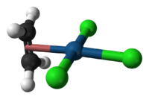
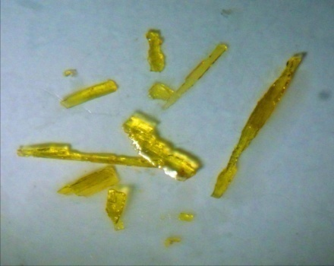

Zeise’s Salt- The first transition metal organometallic compound
Discovery 1827
Structure ~ 150 years later
W C Zeise, Danish pharmacist, I789- I847
‘The breakthrough, the isolation of a pure, crystalline compound came when Zeise added potassium chloride to a concentrated PtCl₄ /ethyl alcohol reaction solution and evaporated the resulting solution. Beautiful lemon yellow crystals, often one half inch or more in length were isolated. On longer exposure to air and light, they gradually became covered with a black crust. They contained water of hydration, which was lost when they were kept over concentrated sulfuric acid in vacuo or when heated to around 100°C. Chemists in those days often reported how the compounds that they had prepared tasted. Zeise described the taste of this potassium salt as metallic, astringent and long lasting.’
Dietmar Seyferth, Organometallics, 2001, 20, 2
Also father of the chemistry of mercaptans R-SH

Slide 5
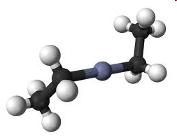
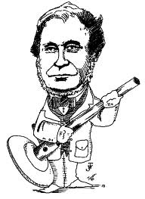
First σ bonded Organometallic Compound- Diethyl zinc
3 C₂H₅I + 3 Zn → (C₂H₅)₂Zn + C₂H₅ZnI + ZnI₂
Edward Frankland 1825-1899
Student of Robert Bunsen (Bunsen burner fame!). Prepared diethyl zinc while trying to make ethyl radicals.
Frankland coined the term “Organometallic”
As the early 1850s English chemist Edward Frankland described flasks exploding, throwing bright green flames across his lab, as he heroically distilled dialkylzinc compounds under an atmosphere of hydrogen.

Slide 6
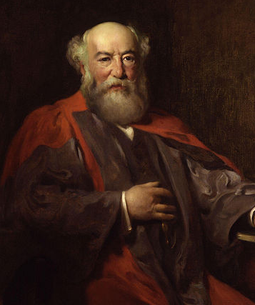
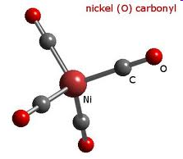
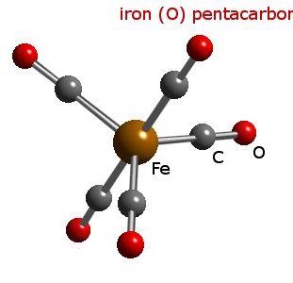
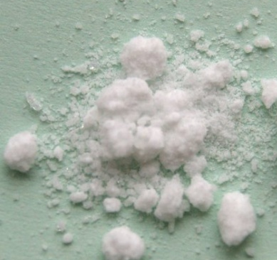
Metal carbonyls
Ludwig Mond 1839-1909
Father of Metal Carbonyl Chemistry
Founder of Imperial Chemical Industry, England
‘Mond nickel company’ was making over 3000 tons of nickel
in 1910 with a purity level of 99.9%
1890-1930 textbooks
Mo(CO)₆

Slide 7
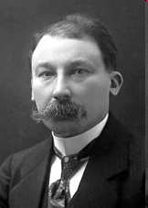
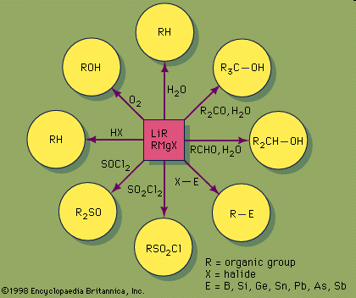
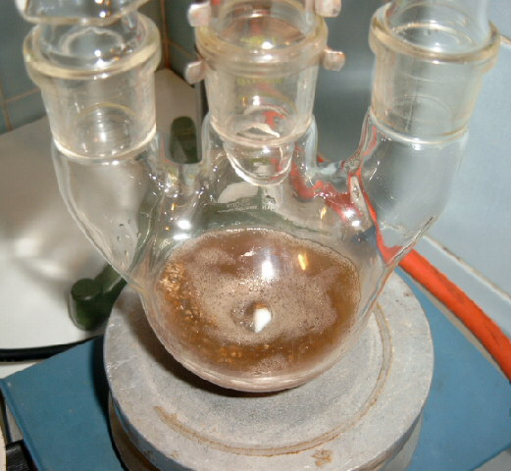
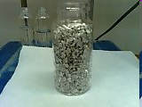
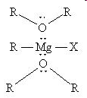
The Grignard Reagent
He was the student of Philippe Barbier (Barbier reaction [Zn]) He discovered the Grignard reaction [Mg]) in 1900. He became a professor at the University of Nancy in 1910 and was awarded the Nobel Prize in Chemistry in 1912.
François Auguste Victor Grignard 1871-1935

Slide 8


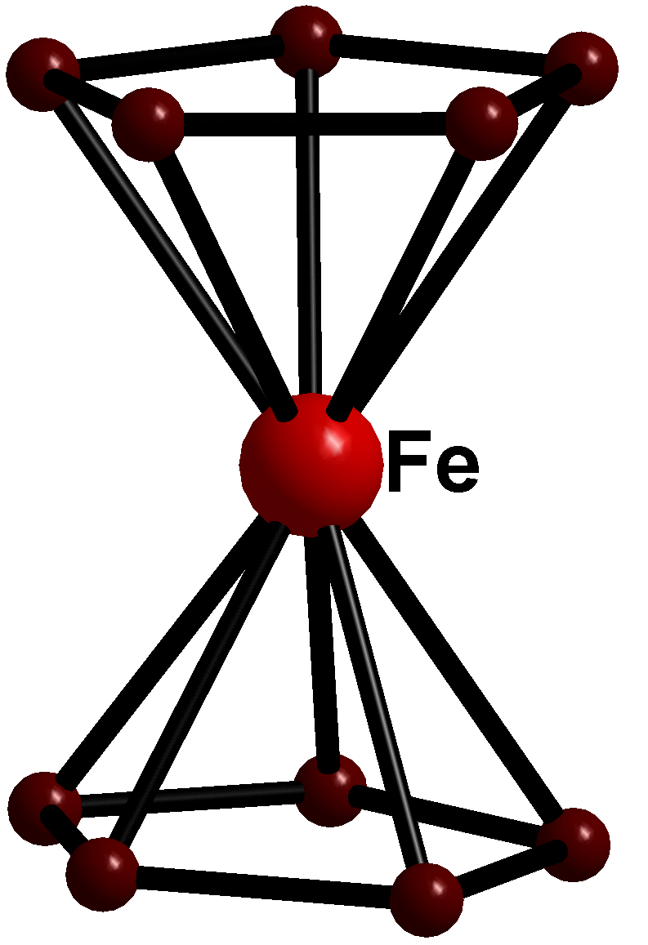

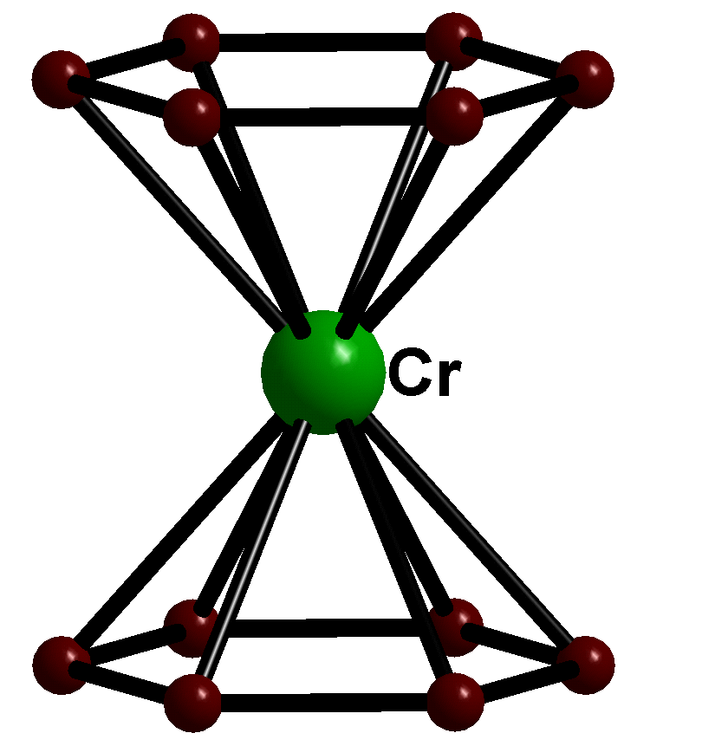
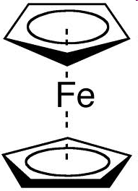
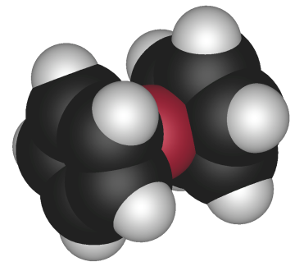
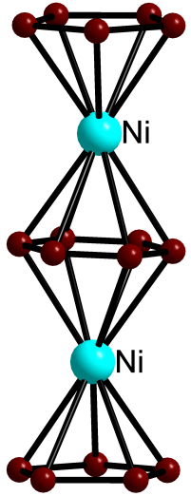
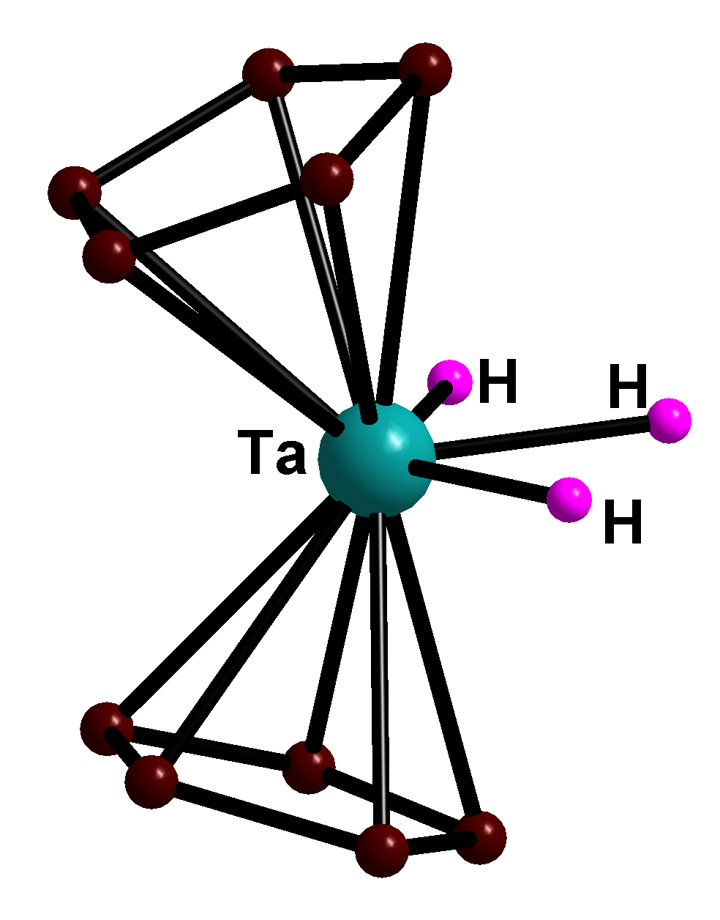
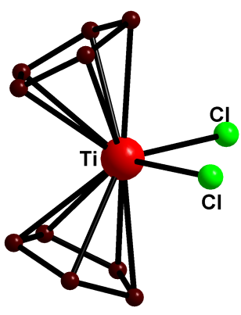
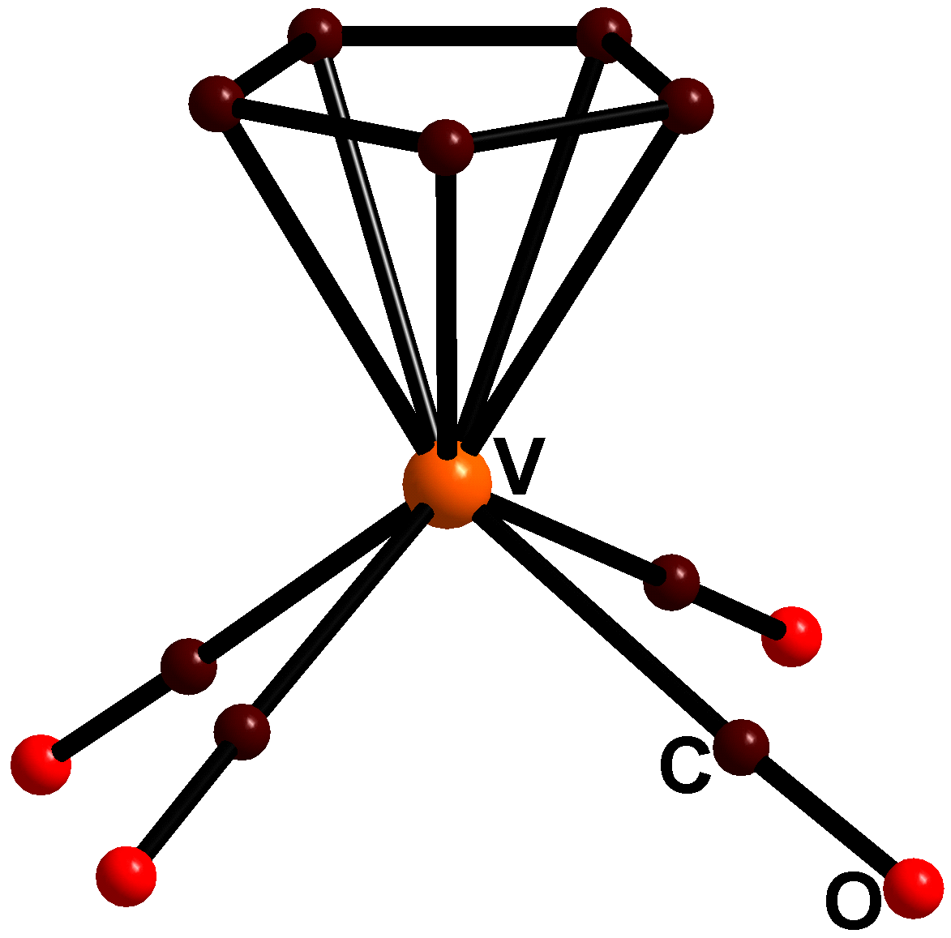
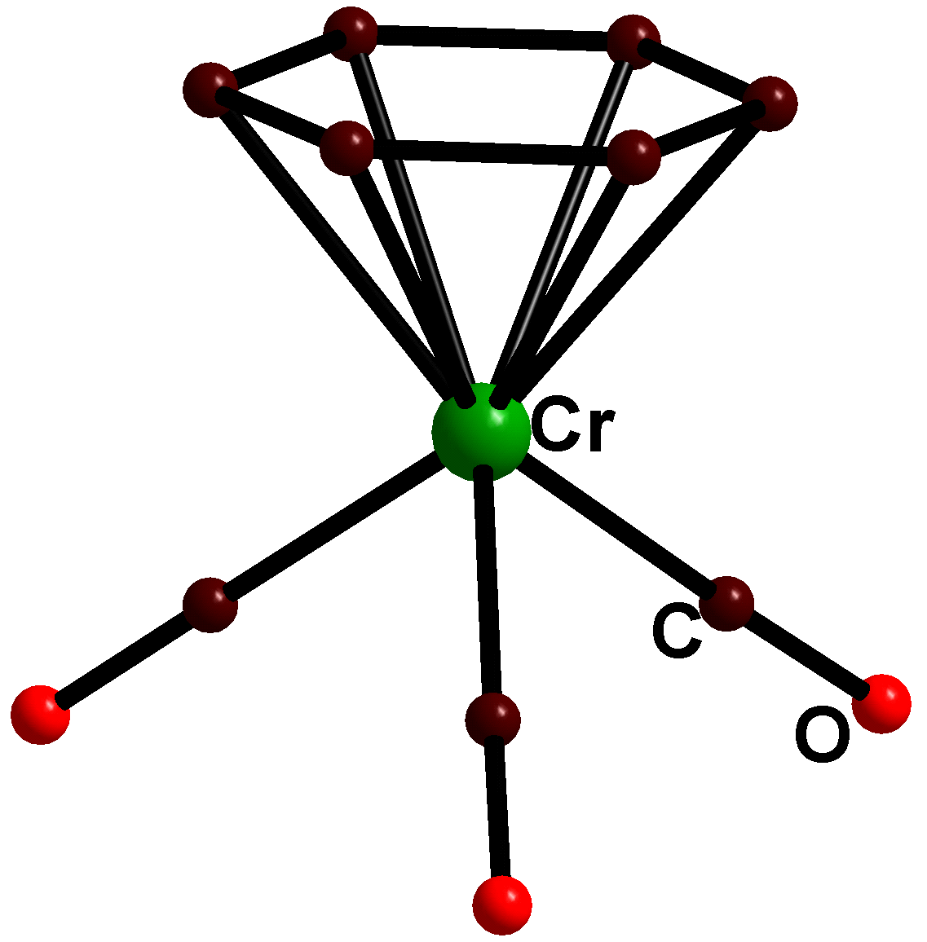
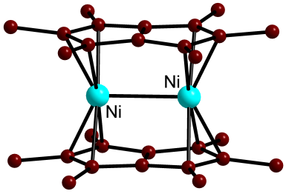
Hapto ligands and Sandwich compounds
The hapto symbol, η, with a numerical superscript, provides a topological description by indicating the number of carbon atoms at a bonding distance to the metal
Sandwich
(η⁵-C₅H₅)₂Fe
(η⁶-C₆H₆)₂Cr
Bent Sandwich
Half Sandwich
Triple decker & polycyclic

Slide 9
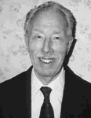

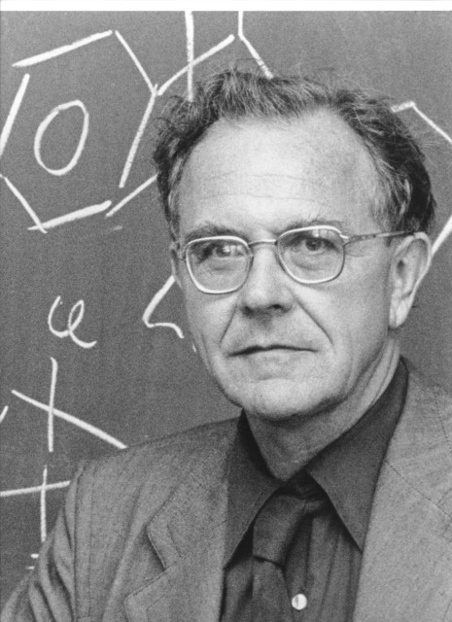
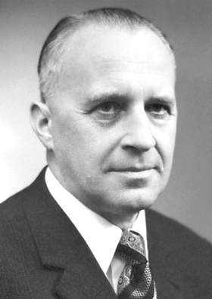
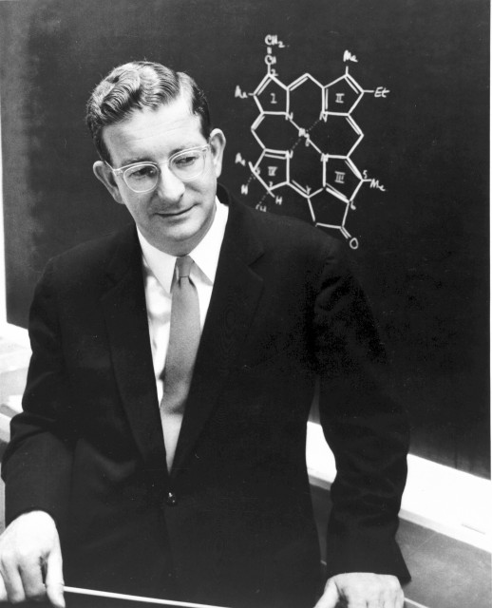
Ferrocene: Pathbreaking discovery of a sandwich compound
Kealy
Pauson
expected fulvalene
A new type of organo-iron compound, Nature 1951
Dicyclopentadienyl iron, J. Chem. Soc., 1952
Ferrocene
G. Wilkinson
1973 Nobel Prize
‘sandwich compounds’
E. O. Fischer
R. B. Woodward
1965 Nobel Prize
‘art of organic synthesis’
Wilkinson, Rosenblum, Whitney, Woodward, J. Am. Chem. Soc., 1952

Slide 10
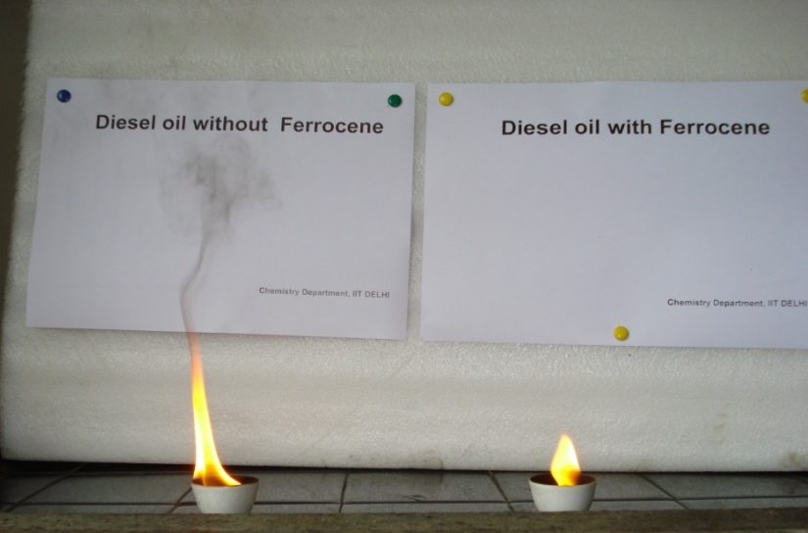
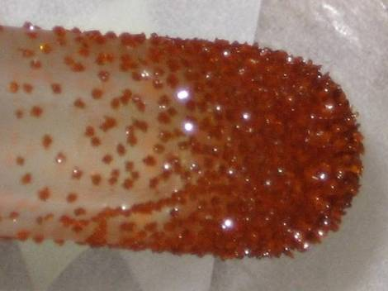
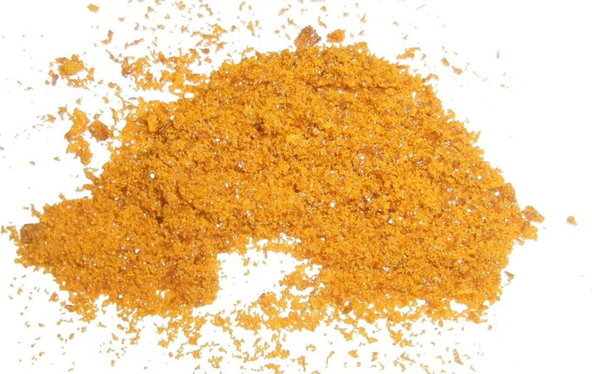
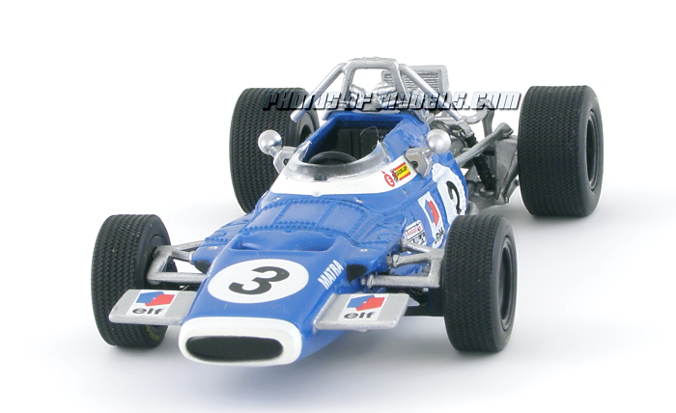
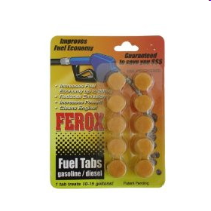
Ferrocene: Fuel additive, smoke suppressant and chiral catalyst precursor
Ferrocene powder
Ferrocene crystals
Ferox Gas & Diesel Fuel Additive is a catalyst that is an eco-friendly fuel additive and horsepower booster. It allegedly increases mileage from between 10 and 20% while also significantly reducing harmful emissions.

Slide 11
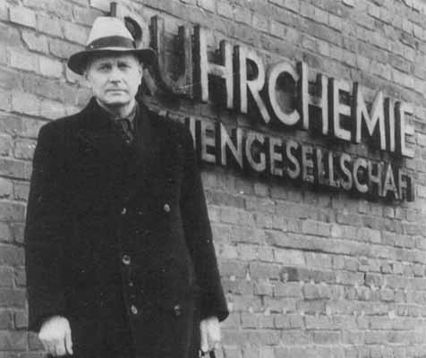
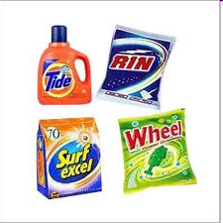

First organometallics in homogeneous catalysis-
The Hydroformylation (1938)
Otto Roelen
Pioneer in Industrial
homogeneous catalysis
(1897-1993)
First Industrial plant- hydroformylation
detergents

Slide 12

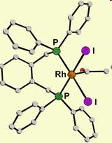
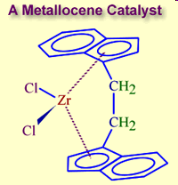
Organometallic catalysts in industrial synthesis : Three Nobel Prizes 2000, 2005 and 2010
Hydrogenation
Methanol to acetic acid process
Olefin polymerization and oligomerization

Slide 13
18 electron rule : How to count electrons
The rule states that thermodynamically stable transition metal organometallic compounds are formed when the sum of the metal d electrons and the electrons conventionally considered as being supplied by the surrounding ligands equals 18.
In general, the conditions favouring adherence to the 18 electron rule are, an electron rich metal (one that is in a low oxidation state) and ligands that are good π-acceptors
The hapto symbol, η, with a numerical superscript, provides a topological description by indicating the connectivity between the ligand and the central atom. For example, if all the five carbon atoms of a cyclopentadienyl moiety are equidistant from a metal atom, we term it as η5-cyclopentadienyl
Examples:
η¹-R, η¹-Ar η²-C₂R₄ η¹-allyl, η³-allyl, η⁴- Cb, η⁵-Cp, η⁶-C₆H₆ η⁸-C₈H₈ η²-C₆₀, η⁵-R₅C₆₀.
The symbol μ indicates bridging normally we have μ₂ and rarely μ₃ bridging
Examples:
μ₂-CO, μ₃-CO, μ₂-CH₃, μ₂-H, μ₂-Cl, , μ₃-Cl, μ₂-OR, μ₂-PR₂, μ₂-NR₂

Slide 14
Methods of counting: Neutral atom method & Oxidation state method
Ligand | Neutral atom | Oxidation state |  | Ligand | Neutral atom | Oxidation state
 |  | Electron contribution | Formal charge |  |  | Electron contribution | Formal charge
Carbonyl (M–CO) | 2 | 2 | 0 | Halogen ( M–X) | 1 | 2 | –1
Phosphine (M–PR₃) | 2 | 2 | 0 | Alkyl (M–R) | 1 | 2 | –1
Amine (M–NR₃ ) | 2 | 2 | 0 | Aryl (M–Ar) | 1 | 2 | –1
Amide (M–NR₂ ) | 1 | 2 | –1 | acyl (M–C(O)–R | 1 | 2 | –1
Hydrogen (M–H) | 1 | 2 | –1 | η¹-cyclopentadienyl | 1 | 2 | –1
Alkene (sidewise) η²- | 2 | 2 | 0 | η¹-allyl | 1 | 2 | –1
Alkyne (sidewise) η²- | 2 | 2 | 0 | η³-allyl | 3 | 4 | –1
η²-C₆₀ | 2 | 2 | 0 | η⁵-cyclopentadienyl | 5 | 6 | –1
Nitrosyl bent | 1 | 2 | –1 | η⁶-benzene | 6 | 6 | 0
Nitrosyl linear | 3 | 2 | +1 | η⁷-cycloheptatrienyl | 7 | 6 | +1
Carbene (M=CR₂) | 2 | 4 | –2 | Carbyne (M≡CR) | 3 | 6 | –3
Alkoxide (M–OR) | 1 | 2 | –1 | Thiolate (M–SR) | 1 | 2 | –1
μ-CO (M–(CO)–M) | 2 | 2 | 0 | μ-H | 1 | 2 | –1
μ-alkyne | 4 | 4 | 0 | μ-X (M–X–M) X = halogen | 3 | 4 | –1
μ-alkyl | 1 | 2 | –1 | μ-amido (M–(NR₂)–M | 3 | 4 | –1
μ-phosphido (M–(PR₂)–M | 3 | 4 | –1 | μ-alkoxide (M–(OR)–M | 3 | 4 | –1

Slide 15
Neutral atom method: Metal is taken as in zero oxidation state for counting purpose
Oxidation state method: We first arrive at the oxidation state of the metal by considering the number of anionic ligands present and overall charge of the complex
Suggestion: Focus on one counting method till you are confident

Slide 16
Easy way to remember ligand electron contribution for neutral atom counting method
Electron contribution
Neutral terminal : CO, PR₃, NR₃ 2 electrons
Anionic terminal : X-, H-, R-, Ar-, R₂N-, R₂P-, RO- 1 electron
Hapto ligands : η²-C₂R₄ η²-C₂R₂, η⁴-C₂R₂ ,η¹-allyl,
η³-allyl, η⁴- Cb, η⁵-Cp, η⁶-C₆H₆
η⁷-C₇H₇ η⁸-C₈H₈ η²-C₆₀, η⁵-R₅C₆₀ same as hapticity
bridging neutral μ₂-CO, μ₃-CO 2 electrons
Bridging anionic μ₂-CH₃, μ₂-H ( no lone pairs) 1 electron
Bridging anionic μ₂-Cl, , μ₂⁻OR, μ₂-PR₂, μ₂-NR₂ 3 electrons
(with 1 lone pair)
μ₃-Cl( 2 l.p) 5 electrons
Bridging alkyne 4 electrons
NO linear 3 electrons
NO bent ( l. p on nitrogen) 1 electron
Carbene M=C 2 electron
Carbyne M≡C 3 electron

Slide 17
How to determine the total number of metal - metal bonds
Determine the total valence electrons (TVE) in the entire molecule (that is, the number of valence electrons of the metal plus the number of electrons from each ligand and the charge); say, it is A.
Subtract this number from n × 18 where n is the number of metals in the complex, that is, (n × 18) – A; say, it is B.
B divided by 2 gives the total number of M–M bonds in the complex.
(b) A divided by n gives the number of electrons per metal. If the number of electrons is 18, it indicates that there is no M–M bond; if it is 17 electrons, it indicates that there is 1 M–M bond; if it is 16 electrons, it indicates that there are 2 M–M bonds and so on.
Molecule | TVE (A) | (18 × n) – A (B) | Total M–M bonds (B/2) | Bonds per metal | Basic geometry of metal atoms
Fe₃(CO)₁₂ | 48 | 54 – 48 = 6 | 6/2 = 3 | 48/3 = 16; 2
Co₄(CO)₁₂ | 60 | 72 – 60 = 12 | 12/2 = 6 | 60/4 = 15; 3
[η⁵-CpMo(CO)₂]₂ | 30 | 36 – 30 = 6 | 6/2 = 3 | 30/2 = 15; 3 | Mo≡Mo
(η⁴-C₄H₄)₂Fe₂(CO)₃ | 30 | 36 – 30 = 6 | 6/2 = 3 | 30/2 = 15; 3 | Fe≡Fe
Fe₂(CO)₉ | 34 | 36 – 34 = 2 | 2/2 = 1 | 34/2 = 16; 1 | Fe–Fe

Slide 18
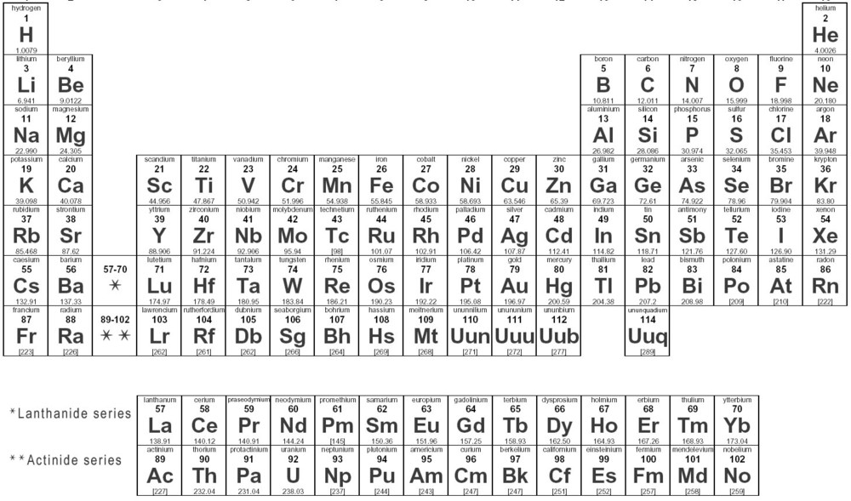
Problem solving
The following organometallic compounds are stable and has a second row transition metal at its centre. Find out the metal and its oxidation state

Slide 19
A few worked out examples
Understanding metal –metal bond electron count become easier if you compare and see how octet is attained by each Cl atom of Cl₂

Slide 20
Exceptions to the 18 electron rule
Square planar organometallic complexes of the late transition metals (16e).
Some organometallic complexes of the early transition metals (e.g. Cp₂TiCl₂, WMe₆, Me₂NbCl₃, CpWOCl₃) [ A possible reason for the same is that some of the orbitals of these complexes are too high in energy for effective utilization in bonding or the ligands are mostly σ donors.]
Some high valent d⁰ complexes have a lower electron count than 18.
Sterically demanding bulky ligands force complexes to have less than 18 electrons.
The 18 electron rule fails when bonding of organometallic clusters of moderate to big sizes (6 Metal atoms and above) are considered.
The rule is not applicable to organometallic compounds of main group metals as well as to those of lanthanide and actinide metals.

Slide 21
Metal carbonyls
Coordination number around the metal normally remains six or lesser. 17 electron species such as Mn(CO)_{5,} Co(CO)₄ dimerize to gain 18 electrons
V(CO)₆ does not dimerize.

Slide 22
Why study metal carbonyls ?
Simplest of organometallic compounds where M-C σ bonding is well understood. CO is one of the strongest π acceptor ligands. Back bonding (π bonding) and variation in electronic properties of CO can be monitored very efficiently by Infrared spectroscopy
A range of metal carbonyls are used as catalysts in Chemical Industry
Hydroformylation
Alkene to Aldehyde
Methanol to Acetic acid Process

Slide 23
Molecular Orbital diagram of CO
Why does CO bind a metal through its less electronegative carbon atom than its more electronegative oxygen ? What makes it a good π acceptor ?
The highest occupied molecular orbital (HOMO) of CO is weakly antibonding (compared with the O atomic orbitals) and is an MO which is carbon based. Secondly, the π* antibonding orbital which is the lowest unoccupied molecular orbital (LUMO) is also of comparatively lower energy which makes it possible to interact with metal t_{2g} orbitals for π bonding. There exists a strong back bonding of metal electrons to the π * antibonding orbitals of CO

Slide 24
Counting the electrons helps to predict stability of metal carbonyls. But it will not tell you whether a CO is bridging or terminal

Slide 25
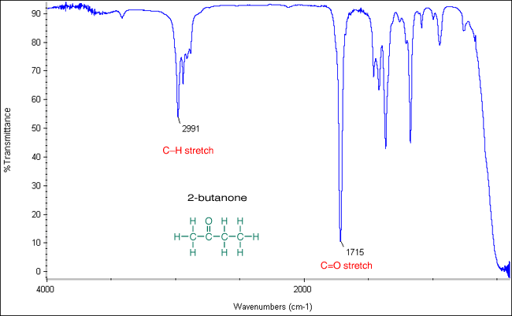
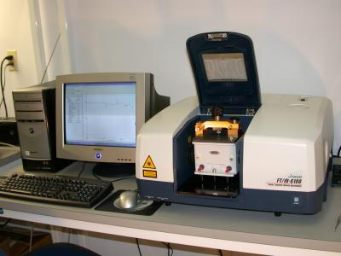
Infrared Spectroscopy- A spectro-analytical tool in chemistry
Infrared (IR) spectroscopy is one of the most common spectroscopic techniques used by organic and inorganic chemists. Simply, it is the absorption measurement of different IR frequencies by a compound positioned in the path of an IR beam. The main goal of IR spectroscopic analysis is to determine the chemical functional groups in the sample. Functional groups are identified based on vibrational modes of the groups such a stretching, bending etc. Different vibrational modes absorb characteristic frequencies of IR radiation. An infrared spectrophotometer is an instrument that passes infrared light through a molecule and produces a spectrum that contains a plot of the amount of light transmitted on the vertical axis against the wavelength of infrared radiation on the horizontal axis. Absorption of radiation lowers the percentage transmittance value.

Slide 26
Infrared Spectroscopy- Spectra of Metal Carbonyls
The range in which the band appears decides bridging or terminal .
The number of bands is only related to the symmetry of the molecule
^{terminal}
bridging
^{terminal}

Slide 27
Terminal versus bridging carbonyls
2000 cm-1
2018, 1826 cm-1
1620 cm-1

Slide 28
Factors which affect ν_{CO} stretching frequencies
1.Charge on the metal
2. Effect of other ligands
Variation in ν_{CO} (cm^{–1}) of the first row transition metal carbonyls
 | free CO 2143
Ni(CO)₄ 2057
Co(CO)₄⁻ 1890 |  | Co₂(CO)₈ 2044(av, ter)
[Fe(CO)₄]²⁻ 1815 |  | Fe(CO)₅ 2030
[Mn(CO)₄]³⁻ 1600,1790 | Mn(CO)₆ + 2098 | Mn₂(CO)₁₀ 2013 (av)
[Cr(CO)₄]⁴⁻ 1462,1657 | Cr(CO)₆ 2000
 | V(CO)₆¯ 1860 | V(CO)₆ 1976
 | Ti(CO)₆²⁻ 1747
As the electron density on a metal centre increases, more π-back­bonding to the CO ligand(s) takes place. This weakens the C–O bond further as more electron density is pumped into the empty π* anti-bonding carbonyl orbital. This increases the M–C bond order and reduces the
C-O bond order. That is, the resonance structure M=C=O becomes more dominant.
More back bonding

Slide 29
Other spectator ligands: Phosphines
PR₃ | ν_{CO,} (cm^{–1}) | (cm^{–1}) Δ ν_{CO} wrt P(t-Bu)₃ | PR₃ | ν_{CO}, (cm^{–1}) | (cm^{–1}) Δ ν_{CO} wrt P(t-Bu)₃
P(t-Bu)₃ | 2056.1 | 0.0 | PPh₂(C₆F₅) | 2074.8 | 18.7
PCy₃ | 2056.4 | 0.3 | P(OEt)₃ | 2076.3 | 20.2
P(i-Pr)₃ | 2059.2 | 3.1 | P(p-C₆H₄-CF₃)₃ | 2076.6 | 20.5
PEt₃ | 2061.7 | 5.6 | P(OMe)₃ | 2079.5 | 23.4
P(NMe₂)₃ | 2061.9 | 5.8 | PH₃ | 2083.2 | 27.1
PMe₃ | 2064.1 | 8.0 | P(OPh)₃ | 2085.3 | 29.2
PBz₃ | 2066.4 | 10.3 | P(C₆F₅)₃ | 2090.9 | 34.8
P(o-Tol)₃ | 2066.6 | 10.5 | PCl₃ | 2097.0 | 40.9
PPh₃ | 2068.9 | 12.8 | PF₃ | 2110.8 | 54.7
PPh₂H | 2073.3 | 17.2 | P(CF₃)₃ | 2115.0 | 58.9

Slide 30
Effect of a ligands trans to CO
Effect of different co-ligands on ν_{CO} (cm⁻¹) of Mo(CO)₃L₃
Complex (fac isomers) | ν _{CO} cm^{–1}
Mo(CO)₃(PF₃)₃ | 2090, 2055
Mo(CO)₃(PCl₃)₃ | 2040, 1991
Mo(CO)₃[P(OMe)₃]₃ | 1977, 1888
Mo(CO)₃(PPh₃)₃ | 1934, 1835
Mo(CO)₃(NCCH₃)₃ | 1915, 1783
Mo(CO)₃(dien)* | 1898, 1758
Mo(CO)₃(Py)₃ | 1888, 1746
More back bonding =
More lowering of the C=O bond order = More lower ν _{CO} stretching frequency
With each negative charge added to the metal centre, the CO stretching frequency decreases by approximately 100 cm–1.
The better the σ donating capability of the other ligands on the metal, more electron density given to the metal, more back bonding (electrons in the antibonding orbital of CO) and lower the CO stretching frequency.

Slide 31
Synthesis of Metal Carbonyls
Direct carbonylation
Reductive carbonylation

Slide 32
Reactions of Metal Carbonyls
In the presence of UV radiation a monodentate ligand displaces only one CO unit

Slide 33
Reactions of Metal Carbonyls

Slide 34
Problem solving - synthesis
Give a scheme for the synthesis of Mn(CO)₄(PPh₃)[C(O)CH₃] starting from Manganese acetate, Mn(OAc)₂.

Slide 35

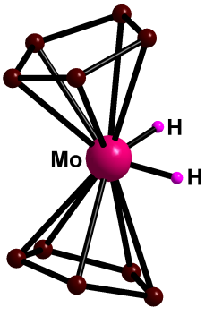
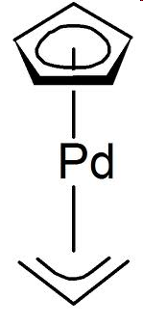








Metal- Sandwich compounds
Hapticity of sandwich compounds varies from 1-8

Slide 36

Why metal – sandwich compounds are important?
1. Transition metal/ metal ion embedded inside an organic matrix: Makes a metal ion soluble even in hydrocarbon solvents. E.g. Ferrocene is soluble in hexane while Fe2+ as such is not. Outcome: a hydrocarbon soluble additive/catalyst
2. Coordination to an electropositive metal often changes the reactivity and electronic properties of the π system bound to it (benzene vs ferrocene)
3. A stericially protected metal site where a wide range of catalytic applications are possible on the. e.g alkene polymerization
4. Metal sandwich compounds are excellent substrates to make planar chiral compounds. Applications as chiral catalysts in asymmetric catalysis
Planr chirality:
Non- super-imposable mirror images

Slide 37
Cyclopentadienyl (Cp−)
Cyclopentadienyl (Cp−) the most important of all the polyenyl ligands
It gets firmly bound to the metal
generally inert to nucleophilic reagents.
used as a stabilising ligand for many complexes.
(η5-Cp)(η3-Cp)W(CO)₂
Neutral cyclopentadiene (C₅H₆) is a weak acid with a pKa of around 15
Deprotonated with strong base or alkali metals to generate the anionic Cp−

Slide 38
Synthesis of Cp (C₅H₅-) based sandwich compounds
CpTl based chemistry is not practiced nowadays due to toxicity

Slide 39
Ferrocene: synthesis
Lab Synthesis

Slide 40


Reactions of Ferrocene
Ferrocene undergoes electrophilic substitution reactions. Many of its reactions are faster than similar reactions of benzene
Necessary requirement: The electrophile should not be oxidizing in nature
The oxidized Cp₂Fe+, ferrocenium cation, will repel the electrophile away. Therefore direct nitration, halogenation and similar reactions cannot be carried out on ferrocene.
Acetylation
3.3 x 10⁶ times faster than benzene

Slide 41
Chloromercuration (hazardous)
109 times faster than benzene
Mannich reaction
Does not happen with benzene; only with phenols/anilines
Lithiation reaction
Does not happen with benzene; only with bromobenzene

Slide 42
Lithiation and 1,1’-di-lithiation – access to range of new derivatives
dppf
[1]ferrocenophane

Slide 43
AJELIAS L2-S22
Polymers with ferrocene in the backbone
Bisbenzene chromium: Prepared by Fischer and Hafner

Slide 44
Problem solving - synthesis
Starting from ferrocene show minimum number of steps for preparing
1,1’- ferrocene dicarboxylic acid

Slide 45
Unique reactions in organometallic chemistry
Oxidative Addition
Reductive Elimination
Migratory Insertion
β - Hydrogen Elimination

Slide 46
Oxidative addition
When addition of ligands is accompanied by oxidation of the metal, it is called an oxidative addition reaction
OX state of metal increases by 2 units
Coordination number increases by 2 units
2 new anionic ligands are added to the metal
Requirements for oxidative addition
availability of nonbonded electron density on the metal,
two vacant coordination sites on the reacting complex (L_{n}M), that is, the complex must be coordinatively unsaturated,
a metal with stable oxidation states separated by two units; the higher oxidation state must be energetically accessible and stable.

Slide 47
Examples of Oxidative addition : Cis or trans ?
Homonuclear systems (H₂, Cl₂, O₂, C₂H₂) Cis
Heteronuclear systems (MeI) Cis or trans

Slide 48

An important step in many homogeneous catalytic cycles
Hydrogenation of alkenes- Wilkinson catalyst
Methanol to acetic acid conversion- Cativa process
Often the first step of the mechanism
Pd catalyzed Cross coupling of Ar-B(OH)₂ and Ar-X – Suzuki Coupling
The more electron rich the metal, more easy is the oxidative addition

Slide 49
Oxidative addition involving C-H bonds and cyclo/ortho metallation
Agostic interaction
This type of reactions help to activate unreactive hydrocarbons such as methane – known as C-H activation

Slide 50

Reductive elimination
Almost the exact reverse of Oxidative Addition
Pt⁴⁺
Pt²⁺
Oxidation state of metal decreases by 2 units
Coordination number decreases by 2 units
2 cis oriented anionic ligands form a stable σ bond and leave the metal
Factors which facilitate reductive elimination
a high formal positive charge on the metal,
the presence of bulky groups on the metal, and
an electronically stable organic product.
Cis orientation of the groups taking part in reductive elimination is a MUST

Slide 51
Final step in many catalytic cycles
Hydroformylation ( conversion of an alkene to an aldehyde)
Sonogashira Coupling (coupling of a terminal alkyne to an aryl group
Cativa Process (Methanol to Acetic acid)

Slide 52
Migratory Insertion
No change in the formal oxidation state of the metal
A vacant coordination site is generated during a migratory insertion (which gets occupied by the incoming ligand)
The groups undergoing migratory insertion must be cis to one another
These reactions are enthalpy driven and although the reaction is entropy prohibited the large enthalpy term dominates

Slide 53
Types of Migratory Insertion

Slide 54
Stability of σ Bonded alkyl groups as ligands
Why does some σ bonded alkyl complexes decompose readily?

Slide 55

β-Hydride elimination
Beta-hydride elimination is a reaction in which an alkyl group having a β hydrogen, σ bonded to a metal centre is converted into the corresponding metal-bonded hydride and a π bonded alkene. The alkyl must have hydrogens on the beta carbon. For instance butyl groups can undergo this reaction but methyl groups cannot. The metal complex must have an empty (or vacant) site cis to the alkyl group for this reaction to occur.
No change in the formal oxidation state of the metal
mechanism
Can either be a vital step in a reaction or an unwanted side reaction

Slide 56
β-hydrogen elimination does not happen when
the alkyl has no β-hydrogen (as in PhCH₂, Me₃CCH₂, Me₃SiCH₂)
(ii) the β-hydrogen on the alkyl is unable to approach the metal (as in C≡CH)
the M–C–C–H unit cannot become coplanar
Select the most unstable platinum σ complex from the given list. Justify your answer
No β-H β-H unable to MCCH unit will not be approach M coplanar

Slide 57
Problem solving
Classify the following reactions as oxidative addition, reductive elimination, (1,1 / 1,2)migratory insertion, β- H elimination, ligand coordination change or simple addition
[RhI₃(CO)₂CH₃]⁻ → {RhI₃(CO)( solvent)[C(O)CH₃]}⁻
Ir(PPh₂Me)₂(CO)Cl + CF₃I → Ir(I)(CF₃)(PPh₂Me)₂(CO)Cl
(c) TiCl₄ +2 Et₃N → TiCl₄ (NEt₃)₂
(d) HCo(CO)₃(CH₂=CHCH₃) + CO → CH₃CH₂CH₂Co(CO)₄
Step 1. determine the oxidation state of the metal in reactant and product
Step 2. count the electrons for reactant and product
Step 3. see if any ligand in the reactant has undergone change

Slide 58






Homogeneous catalysis using organometallic Catalysts
A catalyst typically increases the reaction rates by lowering the activation energy by opening up pathways with lower Gibbs free energies of activation (G).
Heterogeneous
Homogeneous

Slide 59
Homogeneous versus Heterogeneous Catalysis
Parameter | Heterogeneous | Homogeneous
Phase | Gas/solid | Usually liquid/ or solid soluble in the reactants
Required temperature | High | Low ( less than 250°C)
Catalyst Activity | Low | High
Product selectivity | Less (often mixtures) | More
Catalyst recycling | Simple and cost effective | Expensive and complex
Reaction mechanism | Poorly understood | Reasonably well understood
Product separation from catalyst | Easy | Elaborate and sometimes problematic
Fine tuning of catalyst | Difficult | Easy

Slide 60
Heterogeneous Catalyst- Catalytic Converter of a Car
Platinum and Palladium
Platinum and Rhodium
Chemistry at the molecular level – Poorly understood
Home assignment : See Youtube video ‘Catalysis’

Slide 61
AJELIAS L7-S16
Comparing different catalysts; Catalyst life and Catalyst efficiency
Turnover Number (TON)
TON is defined as the amount of reactant (in moles) divided by the amount of catalyst (in moles) times the percentage yield of product. A large TON indicates a stable catalyst with a long life.
Turnover Frequency (TOF)
It is the number of passes through the catalytic cycle per unit time (often per hour). Effectively this is dividing the TON by the time taken for the reaction. The units are just time^{–1} . A higher TOF indicates better efficiency for the catalyst

Slide 62
AJELIAS L7-S17
Wilkinson’s Catalyst for alkene hydrogenation
Wilkinson’s catalyst: The first example of an effective and rapid homogeneous catalyst for hydrogenation of alkenes, active at room temperature and atmospheric pressure.
Square planar 16 electron d⁸ complex (Ph₃P)₃RhCl
Discovered by G Wilkinson as well as by R Coffey almost at the same time (1964–65)

Slide 63
Conventional Catalytic cycle for hydrogenation with Wilkinson’s catalyst
The first step of this catalytic cycle is the cleavage of a PPh₃ to generate the active form of the catalyst followed by oxidative addition of dihydrogen.

Slide 64
Conventional Catalytic cycle for hydrogenation with Wilkinson’s catalyst
The first step of this catalytic cycle is the cleavage of a PPh₃ to generate the active form of the catalyst followed by oxidative addition of dihydrogen.

Slide 65
catalytic cycle for hydrogenation
Kinetic studies have shown that the dissociation of PPh₃ from the distorted square planar complex RhCl(PPh₃)₃ in benzene occurs only to a very small extent (k = 2.3 × 10^{–7} M at 25°C), and
under an atmosphere of H₂, a solution of RhCl(PPh₃)₃ becomes yellow as a result of the oxidative addition of H₂ to give cis-H₂RhCl(PPh₃)₃.
The trans effect is the labilization (making unstable) of ligands that are trans to certain other ligands, which can thus be regarded as trans-directing ligands. The intensity of the trans effect (as measured by the increase in rate of substitution of the trans ligand) follows this sequence:
H₂O, OH− < NH₃ < py < Cl− < Br− < I−, < PR₃, CH₃− < H−, NO, CO

Slide 66
Relative reactivity of alkenes for homogenous catalytic hydrogenation
Cis alkenes undergo hydrogenation more readily than trans alkenes
Internal and branched alkenes undergo hydrogenation more slowly than terminal ones, and

Slide 67
Fine tuning of a catalyst:
hydrogenation catalysts which are more efficient than Wilkinsons catalyst
Catalyst 25°C, 1 atm H₂ | Turnover frequency (TOF) in h^{–1} for hydrogenation of alkenes
Wilkinson’s catalyst | 650 | 700 | 13 | NA
Schrock–Osborn catalyst | 4000 | 10 | NA | NA
Crabtree’s catalyst | 6400 | 4500 | 3800 | 4000
The cationic metal center is relatively more electrophilic than neutral metal center and thus favours alkene coordination.

Slide 68
Hydrogenation with Crabtree’s catalyst
The di-solvated form of the active catalyst generated by the removal of COD [after it gets hydrogenated and leaves] favors coordination of sterically bulky alkenes as well.
This mechanism is only for understanding not for the exam

Slide 69
Factors which have been found to improve the efficiency (better TOF) of transition metal catalysts for hydrogenation
Making a cationic metal center : makes catalyst electrophillic for alkene coordination
Use of ligands (eg. Cyclooctadiene) which will leave at the initial stages of the cycle generating a di-solvated active catalyst : facilitates binding of even sterically hindered alkenes
Use of chelating biphosphines: Cis enforcing: reduces steric hindrance at the metal centre
Cis enforcing

Slide 70
Problem solving- fill in the blanks
Oxidative addition
1,2 Migr. Insertion
1,1 Migr. Insertion

